Slide 1
Rutgers University
School of Engineering
Fall 2022
332:231 – Digital Logic Design
Sophocles J. Orfanidis
ECE Department orfanidi@rutgers.edu
Unit 6 – Sequential circuits, latches, flip-flops

Slide 2
Course Topics
1. Introduction to DLD, Verilog HDL, MATLAB/Simulink
2. Number systems
3. Analysis and synthesis of combinational circuits
4. Decoders/encoders, multiplexers/demultiplexers
5. Arithmetic systems, comparators, adders, multipliers
6. Sequential circuits, latches, flip-flops (Wakerly, Ch. 9 & 10)
7. Registers, shift registers, counters, LFSRs (Wakerly, Ch. 11)
8. Finite state machines, analysis and synthesis (Wakerly, Ch. 9)
Text: J. F. Wakerly, Digital Design Principles and Practices, 5/e, Pearson, 2018
additional references on Canvas Files > References

Slide 3
Sequential circuits (Wakerly, Ch. 9 & 10)
Topics discussed are:
Finite state machines – Mealy/Moore
State-holding elements – bistable elements
SR latches / SʹRʹ latches
D latches
D flip-flops
T flip-flops
JK flip-flops
Converting between flip-flop types

Slide 4
Unit-6 Contents:
1. Finite state machines – Mealy/Moore
2. State-holding elements – bistable elements
3. SR latch
4. SʹRʹ latch
5. D latch
6. D flip-flops
7. T flip-flops
8. JK flip-flops
9. Converting between flip-flop types

Slide 5
sequential circuits and finite state-machines are special cases of dynamic systems
x(t)
system
y(t)
inputs
outputs
In general, a system can be defined by specifying the
I/O computational rule that determines the output signal y(t) from the input signal x(t).
The time variable t can be continuous or discrete. The system can be linear or non-linear, time-invariant or time-varying, and can be described by differential or difference equations.

Slide 6
State Machines
State-space realizations, also known as state-space models, have a very large number of applications in many diverse fields, such as,
digital logic design
differential equations for physical systems
system theory
electric circuits
linear systems
digital signal processing
control systems
communication systems
biomedical signal processing
geophysical signal processing
aerospace engineering
military systems
statistics and time series analysis
predictive analytics
econometrics and financial engineering

Slide 7
State Machines
State-space realizations are very powerful representations of systems (linear or nonlinear, time-invariant or not).
The system is described by a set of internal states at each time instant t, denoted for example by Q(t), and these states are used to compute the current output y(t) in terms of the current input x(t), and then update the states to their next values, Q(t+1), so that they can be used at time t+1 (or, more generally at, t+Δt).
In other words, the system’s time evolution is described iteratively by a computational algorithm of the form,
for each time instant t, do:
y(t) = f(x(t), Q(t)) (compute output)
Q(t+1) = g(x(t), Q(t)) (update state)
[ to get started, one needs to know the initial state, Q(0), at t=0 ]
for each time instant t, do:
y(t) = G(x(t), Q(t))
Q(t+1) = F(x(t), Q(t))

Slide 8
State Machines
For example, in going from time t to time t+2, one carries out the steps:
at time t,
y(t) = G(x(t), Q(t))
Q(t+1) = F(x(t), Q(t))
at time t+1,
y(t+1) = G(x(t+1), Q(t+1))
Q(t+2) = F(x(t+1), Q(t+1))
at time t+2,
y(t+2) = G(x(t+2), Q(t+2))
Q(t+3) = F(x+2), Q(t+2))
etc.
F( ) and G( ) depend on application
in DLD, F is referred to as
next-state logic, or excitation logic
and, G is referred to as output logic
from here on, we’ll use the
simplified notation,
x_{t} , y_{t} , Q_{t}
for
x(t), y(t), Q(t)

Slide 9
State Machines
It should be emphasized that the updated state Q_{t+1} is being computed at time t, and becomes available at time t, replacing Q_{t} , but it is saved until it is used later at time t+1.
The computations can be cast as a repetitive algorithm, in which the present state is overwritten by the next state.
initialize state Q (typically at t=0), then,
or,
at each time t, do,
y_{t} = G(x_{t}, Q)
Q = F(x_{t}, Q)
at each time t, do,
y_{t}= G(x_{t}, Q)
Q_{next} = F(x_{t}, Q)
Q = Q_{next}

Slide 10
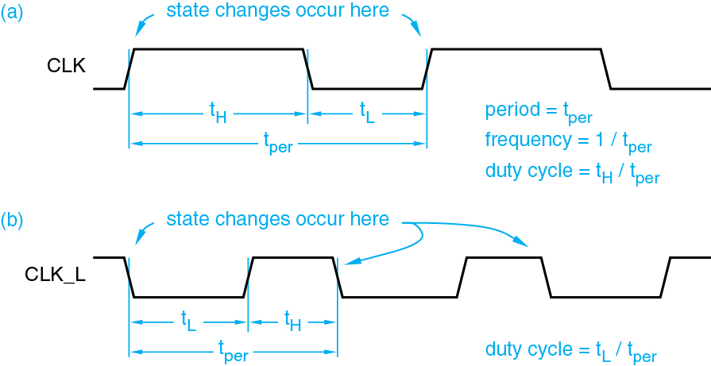
State Machines
DLD notation: we assume that time is discretized in units of 1, which means one clock period, so that t+1 means one clock period ahead of t.
In DLD (essentially all) sequential circuits are synchronously driven by a clock, and the state changes occur during the rising edge of the clock period (or, alternatively - but less commonly - during the falling edge.)
clock period depends on application, e.g., Emona board has 10 μsec period
rising edge
t
clock duty cycles are usually, 50%
falling edge

Slide 11
State Machines
State machines in DLD fall into two general families:
Moore type: output equation depends only on Q, i.e., y = G(Q)
Mealy type: output equation depends on both x and Q, i.e., y = G(x, Q)
for each time instant t, do:
y_{t} = G(x_{t}, Q_{t})
Q_{t+1} = F(x_{t}, Q_{t})
simplified notation
y = G(x, Q)
Q_{next} = F(x, Q)
changes occur at
clock rising edges
in general, one can have multiple inputs, multiple outputs (MIMO systems), and multiple states

Slide 12
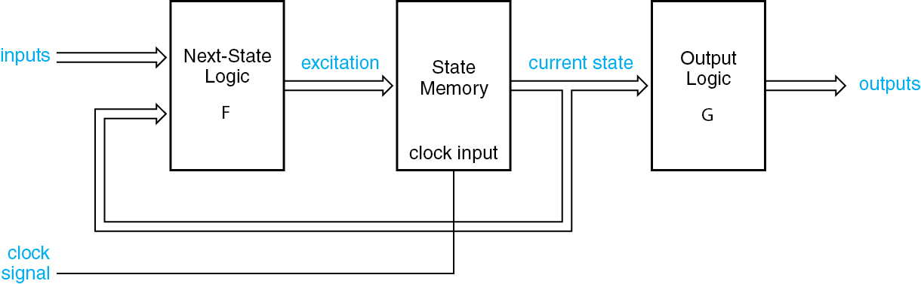
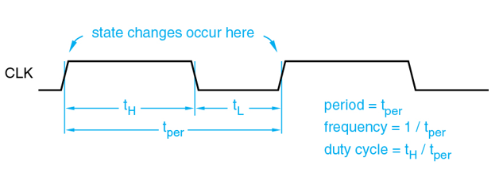
State Machines – Moore
e.g., edge-triggered D-flip-flops
x_{t}
y_{t}
s
Q_{t+1}
Q_{t}
y_{t} = G(Q_{t})
Q_{t+1} = F(x_{t} , Q_{t})
t

Slide 13
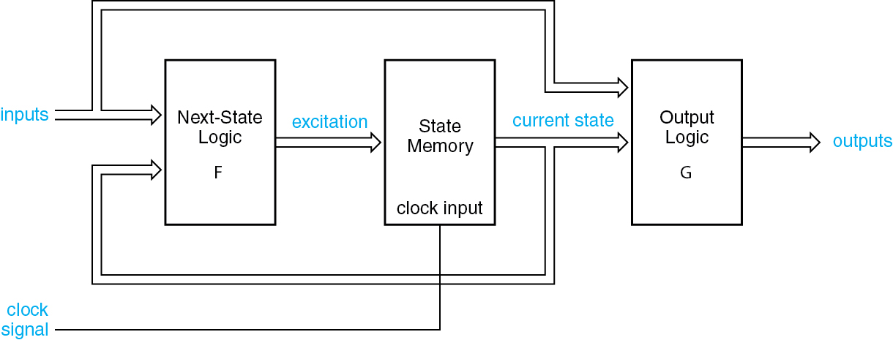
State Machines – Mealy
e.g., edge-triggered D-flip-flops
x_{t}
y_{t}
s
Q_{t+1}
Q_{t}
y_{t} = G(x_{t ,} Q_{t})
Q_{t+1} = F(x_{t} , Q_{t})
t

Slide 14
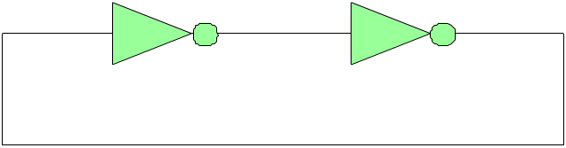
state-holding elements
bistable elements
latches
what are state-holding elements?
how to load them?
Q
Qʹ
Q
two stable states
Q=1 and Q=0
Q=1
Qʹ=0
Q=1
Q=0
Qʹ=1
Q=0

Slide 15
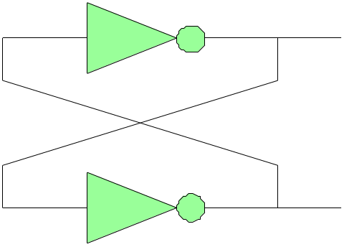
state-holding elements
bistable elements
latches
Q
Qʹ
two stable states - but how to load them?
Q = 1
Q = 0
Qʹ = 0
Qʹ = 1

Slide 16
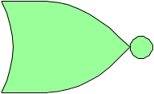
state-holding elements
bistable elements
latches
the state-loading problem is solved with SR latches, which provide external inputs to the bistable elements.
Q
Qʹ
Q
(reset)
R
Q
Qʹ
(set)
S
Q

Slide 17
state-holding elements
bistable elements
latches
S
Q
R
Qʹ
R
Q
Qʹ
S
Q
redrawn
R
Q
S R-latch
NOR version
Qʹ
S

Slide 18
R=0
Q=0/1 before
Q=1 next
normal
operation
S=1
Qʹ=0
Q=0/1
Q=1
set, Q=1 state
R=0
Q=1 before
Q=1 next
S=0
Qʹ=0
S R Q Q_{next}
0 0 Q Q
0 1 Q 0
1 0 Q 1
1 1 Q ?
Q=1
Q=1
hold, Q=1 state
hold
reset
set
R=1
Q=1/0 before
Q=0 next
S=0
Qʹ=0/1
Qʹ=1
Q=1/0
Q=0
reset, Q=0 state
R=0
Q=0 before
Q=0 next
X Y NOR
0 0 1
0 1 0
1 0 0
1 1 0
S=0
Qʹ=1
Q=0
Q=0
hold, Q=0 state

Slide 19
abnormal
operation
R=1
Q=any, before
Q=0 next
S=1
Qʹ=0
Q before
not allowed, Q=0 and Qʹ = 0,
i.e., Qʹ is not the inverse of Q
Q=0
S R Q Q_{next}
0 0 Q Q
0 1 Q 0
1 0 Q 1
1 1 Q ?
hold
reset
set
S
Q
R
QN
R=S=1 are not allowed because if R,S are de-asserted at exactly the same time, that is, R=S=0, then, the latch will enter into a metastable, race condition, with the Q, Qʹ outputs oscillating between the values 0,0 and 1,1, as explained below.
0 0 → 1 1 → 0 0 → 1 1 . . .

Slide 20
R=1
Q = 0
abnormal
operation
not allowed, Q=0 and Qʹ = 0
Qʹ = 0
S=1
S
Q
simultnaneously de-asserting R,S
R
Qʹ
S R Q Q_{next}
0 0 Q Q
0 1 Q 0
1 0 Q 1
1 1 Q ?
R=0
Q = 0,1,0,1, …
hold
reset
set
Qʹ
race condition
Q
Qʹ = 0,1,0,1, …
S=0
R=S=1 are not allowed because if R,S are de-asserted at exactly the same time, that is, R=S=0, then, the latch will enter into a metastable, race condition, with the Q, Qʹ outputs oscillating between the values 0,0 and 1,1, as seen above.
0 0 → 1 1 → 0 0 → 1 1 . . .

Slide 21
R=0
Q
normal
operation
inactive stable state
hold Q and Qʹ
Qʹ
S=0
sequence of events
a → b → c → d → e
d
Q before
Q=1 next
S R Q Q_{next}
0 0 Q Q
0 1 Q 0
1 0 Q 1
1 1 Q ?
R=0
hold
reset
set
c
set, Q=1 state
e
Qʹ before
Qʹ =0 next
S=1
a
b
R=0
e
Q=1 before
Q=1 next
b
d
hold, Q=1 state
b
Qʹ =0 before
Qʹ =0 next
S=0
a
c

Slide 22
a
b
R=1
Q=1 before
Q=0 next
normal
operation
e
c
e
reset, Q=0 state
c
Qʹ =0 before
Qʹ =1 next
S=0
d
sequence of events
a → b → c → d → e
a
c
S R Q Q_{next}
0 0 Q Q
0 1 Q 0
1 0 Q 1
1 1 Q ?
R=0
Q=0 before
Q=0 next
b
d
hold
reset
set
hold, Q=0 state
d
Qʹ =1 before
Qʹ =1 next
S=0
e
R=0
d
Q=0 before
Q=1 next
c
set, Q=1 state
e
Qʹ=1 before
Qʹ =0 next
S=1
a
b

Slide 23
a
b
R=1
Q=1 before
Q=0 next
abnormal
operation
e
c
e
not allowed, Q=0 and Qʹ = 0
c
Qʹ =0 before
Qʹ =0 next
S=1
d
sequence of events
a → b → c → d → e
S R Q Q_{next}
0 0 Q Q
0 1 Q 0
1 0 Q 1
1 1 Q ?
simultnaneously de-asserting R,S
Q=0 before
Q=1 next
Q=0 next, etc
hold
reset
set
a
c
R=0
b
c
sequence of events
a → b → c
b
c
Qʹ =0 before
Qʹ =1 next
Qʹ =0 next, etc
S=0
a
b
latch enters into a metastable, race condition, with the Q, Qʹ outputs oscillating between the values 0,0 and 1,1
0 0 → 1 1 → 0 0 → 1 1 . . .

Slide 24
SR latch
NOR implementation
R
Q
S
Q
R
Qʹ
Qʹ
S
S R Q Q_{next} Qʹ_{next}
0 0 Q Q Qʹ
0 1 Q 0 1
1 0 Q 1 0
1 1 Q 0 0
characteristic equation
Q_{next} = Rʹ S + Rʹ Q
hold
reset
set
not allowed
but with these as “don’t cares”
Q_{next} = S + Rʹ Q
characteristic table

Slide 25
characteristic table
SR latch
S R Q Q_{next} Qʹ_{next}
0 0 Q Q Qʹ
0 1 Q 0 1
1 0 Q 1 0
1 1 Q 0 0
hold
reset
set
not allowed
characteristic equation
Q_{next} = Rʹ S + Rʹ Q
if treated as “don’t cares”
SR
Q
00
01
11
10
0
x
1
Q_{next} = S + Rʹ Q
1
1
x
1

Slide 26
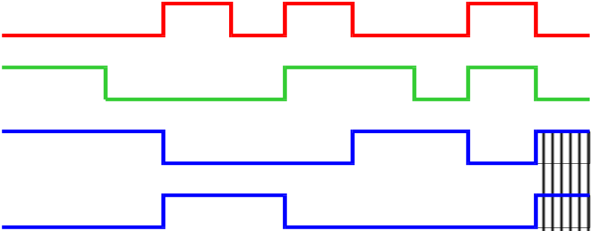
S R Q Q_{next} Qʹ_{next}
0 0 Q Q Qʹ
0 1 Q 0 1
1 0 Q 1 0
1 1 Q 0 0
SR latch
R
Q
Qʹ
S
S
Q
not allowed
R
Qʹ
set
hold
reset
hold
set
hold
R
S
simultnaneously
de-asserted
Q
0
0
0
0
indeterminate,
race condition
Qʹ
t₀
t₁
t₂
t₃
t₄
t₅
t₆
t₇
t₈
t

Slide 27
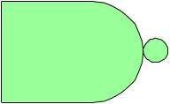
SR latches – NOR and NAND realizations
R
Q
Qʹ
NOR
S
Q
using De Morgan duality theorem:
F(X,Y, Z, …) ʹ = F_{dual} (Xʹ,Yʹ, Zʹ , …)
Rʹ
Qʹ
NAND
Q
Sʹ
Qʹ

Slide 28
state-holding elements
bistable elements
latches
Rʹ
Qʹ
Q
Sʹ
Qʹ
redrawn
Sʹ
Q
S R latch
or
Sʹ Rʹ latch
Qʹ
Rʹ

Slide 29
S R latch
NAND implementation
active low
Sʹ
Q
Sʹ
Q
Rʹ
Qʹ
Qʹ
Rʹ
Sʹ Rʹ Q Q_{next} Qʹ_{next}
0 0 Q 1 1
0 1 Q 1 0
1 0 Q 0 1
1 1 Q Q Qʹ
not allowed
set
reset
hold
characteristic equation
active low
Q_{next} = S + Rʹ Q
Q_{next} = ( Sʹ (Rʹ Q)ʹ )ʹ
active low
characteristic table

Slide 30
S R latch
characteristic table
Sʹ Rʹ Q Q_{next} Qʹ_{next}
0 0 Q 1 1
0 1 Q 1 0
1 0 Q 0 1
1 1 Q Q Qʹ
not allowed
set
reset
hold
characteristic equation
Q_{next} = S + Rʹ Q
SR
Q
00
01
11
10
0
1
1
Q_{next} = S + Rʹ Q
1
1
1
1
same K-map as in the NOR case

Slide 31
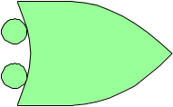
SR latches - Summary
NOR
active low
NAND
SR NAND version
S R Q Q_{next} Qʹ_{next}
1 1 Q 1 1
1 0 Q 1 0
0 1 Q 0 1
0 0 Q Q Qʹ
R
Q
Sʹ
Q
active high
Qʹ
Qʹ
S
Rʹ
S R Q Q_{next} Qʹ_{next}
0 0 Q Q Qʹ
0 1 Q 0 1
1 0 Q 1 0
1 1 Q 0 0
Sʹ Rʹ Q Q_{next} Qʹ_{next}
0 0 Q 1 1
0 1 Q 1 0
1 0 Q 0 1
1 1 Q Q Qʹ
hold
reset
set
xx
xx
set
reset
hold
Q_{next} = Rʹ S + Rʹ Q
Q_{next} = S + Rʹ Q
Q_{next} = S + Rʹ Q
characteristic tables – in both cases, set means Q=1, reset, Q=0

Slide 32
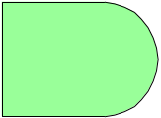
SR latch – with enable/control/clock signal – NOR version
R
R_{a}
Q
C
Qʹ
S
S_{a}
K-map for Q_{next}
S R C Q_{next} Qʹ_{next}
x x 0 Q Qʹ
0 0 1 Q Qʹ
0 1 1 0 1
1 0 1 1 0
1 1 1 0 0
characteristic equation
SR
CQ
00 01 11 10
00 0 0 0 0
01 1 1 1 1
11 1 0 0 1
0 0 0 1
Q_{next} = C Rʹ S + Cʹ Q + Rʹ Q
Q + Rʹ Q = Q
hold
hold
reset
set
not allowed
R_{a} = C R
S_{a} = C S
Q_{next} = R_{a}ʹ S_{a} + R_{a}ʹ Q
see SR latch, p.24
Q_{next} = Rʹ S + Rʹ Q
characteristic table

Slide 33
SR latch – with enable/control/clock signal – NAND version
S
S_{a}ʹ
SR NAND version
Q
S R Q Q_{next} Qʹ_{next}
1 1 Q 1 1
1 0 Q 1 0
0 1 Q 0 1
0 0 Q Q Qʹ
C
Qʹ
R
R_{a}ʹ
K-map for Q_{next}
S R C Q_{next} Qʹ_{next}
x x 0 Q Qʹ
0 0 1 Q Qʹ
0 1 1 0 1
1 0 1 1 0
1 1 1 1 1
SR
CQ
00 01 11 10
00 0 0 0 0
01 1 1 1 1
11 1 0 1 1
0 0 1 1
hold
hold
reset
set
not allowed
characteristic equation
Q_{next} = C S + (Cʹ + Rʹ )Q
Q + Rʹ Q = Q
characteristic table

Slide 34

D latch
NOR implementation
R
R_{a}
D
Q
C
Qʹ
S
S_{a}
K-map for Q_{next}
characteristic table
characteristic equation
DC
Q
D C Q Q_{next}
x 0 Q Q
0 1 Q 0
1 1 Q 1
Q_{next} = C D + Cʹ Q
if C=1,
Q_{next} = D
if C=0,
Q_{next} = Q
00 01 11 10
0 0 0 1 0
1 1 0 1 1
hold Q
follow D
follow D
R_{a} = C Dʹ
S_{a} = C D
Q_{next} = R_{a}ʹ S_{a} + R_{a}ʹ Q
i.e., Q follows D while C=1, otherwise Q remains unchanged

Slide 35
D latch
R_{a} = C Dʹ
S_{a} = C D
Q_{next} = R_{a}ʹ S_{a} + R_{a}ʹ Q
= (C Dʹ)ʹ (CD) + (C Dʹ)ʹ Q
= (Cʹ + D) (CD) + (Cʹ + D) Q
= Cʹ CD + D C D + Cʹ Q + D Q
= C D + Cʹ Q + D Q
= C D + Cʹ Q ( by consensus theorem)

Slide 36
D latch
NAND implementation
D
S_{a}ʹ
Q
C
Qʹ
R_{a}ʹ
characteristic table
characteristic equation
K-map for Q_{next}
D C Q Q_{next}
x 0 Q Q
0 1 Q 0
1 1 Q 1
Q_{next} = C D + Cʹ Q
DC
Q
if C=1,
Q_{next} = D
if C=0,
Q_{next} = Q
00 01 11 10
0 0 0 1 0
1 1 0 1 1
consensus theorem:
Q_{next} = C D + Cʹ Q
= C D + Cʹ Q + D Q
hold Q
follow D
follow D
R_{a} = C Dʹ
S_{a} = C D
Q_{next} = S_{a} + R_{a}ʹ Q
while C=1, Q follows D
while C=0, Q is unchanged
see p.29
turning a D latch into a D flip-flop

Slide 37
latches
vs.
flip-flops
D-latches are level-sensitive storage elements
D-flip-flops are edge-triggered storage elements
clock
C_{t} E_{t}
rising-edge signal
t
D C Q_{next}
x 0 Q
0 1 0
1 1 1
D E Q_{next}
x Q
0 0
1 1
hold Q
follow D
follow D
hold Q
follow D
follow D
D-latch
characteristic equation
level-sensitive
D-flip-flop
characteristic equation
edge-triggered
Q_{next} = C D + Cʹ Q
Q_{next} = E D + Eʹ Q

Slide 38
D flip-flop
positive-edge-triggered
D flip-flop
D
Q
>
Qʹ
clock
D
Q
clock
E
edge signal
rising edges
Qʹ
characteristic table
characteristic equation
D_{t} E_{t} Q_{t+1}
x Q_{t}
0 0
1 1
D_{t} , if t at edge
Q_{t+1} = E_{t} D_{t} + E_{t}ʹ Q_{t} =
Q_{t} , if t not at edge
hold Q
follow D
follow D
i.e., D flip-flop copies D to Q on the rising edge of the clock, and remembers Q at all other times

Slide 39
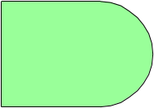

D flip-flop
edge-detector – generating an edge signal from the clock
clock, C
C
E, edge signal
Δ
clock
Cʹ_{del}
small delay
rising edges
Δ
C
Δ
Δ
Cʹ_{del}
E
Δ
narrow pulses
rising edges

Slide 40
latch
latches
vs.
flip-flops
flip-flop
D C Q_{next}
x 0 Q
0 1 0
1 1 1
D
D
Q
D-latch
D E Q_{next}
x Q
0 0
1 1
clock
Clk
Qʹ
level-sensitive
hold
follow
follow
hold
follow
follow
D
Q
D-flip-flop
>
Qʹ
positive-edge-triggered
clock edge
clock level
for the latch,
input variations
are applied only
when clock is ON,
and QL output is preserved while clock is OFF
ON
ON
ON
clock
OFF
OFF
D
D flip-flop copies D to Q on the rising edges of the clock, and remembers Q at all other times
Q
D-latch
for the flip-flop,
input variations
are ignored between clock
rising edges
Q
D-flip-flop
t
t₁
t₁+T_{clock}
t₁+2T_{clock}

Slide 41
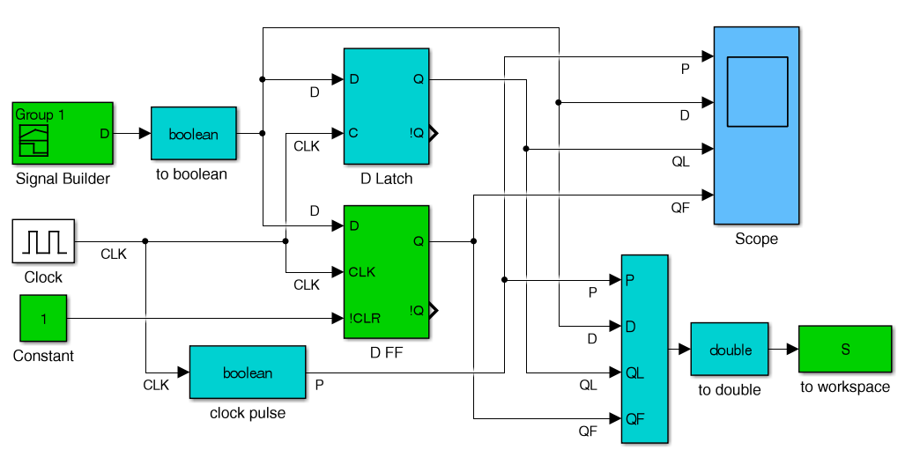
D flip-flop
positive-edge-triggered D flip-flop vs. D latch
D flip-flop copies D to Q on the rising edges of the clock, and remembers Q at all other times
for the latch,
input variations
are applied only
when clock is ON,
and QL output is preserved while clock is OFF
for the flip-flop,
input variations
are ignored between clock
rising edges
DffLs.slx file on Canvas
flip-flops and clock are found in Simulink library under Simulink extras/flip flops

Slide 42
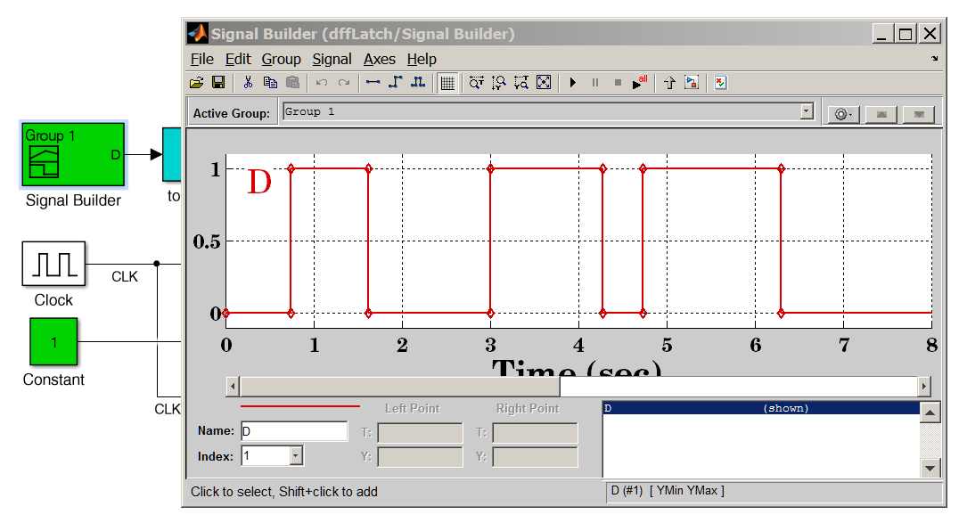
D flip-flop
positive-edge-triggered D flip-flop vs. D latch
D flip-flop copies D to Q on the rising edges of the clock, and remembers Q at all other times
for the latch,
input variations
are applied only
when clock is ON,
and QL output is preserved while clock is OFF
for the flip-flop,
input variations
are ignored between clock
rising edges
rising clock edges

Slide 43
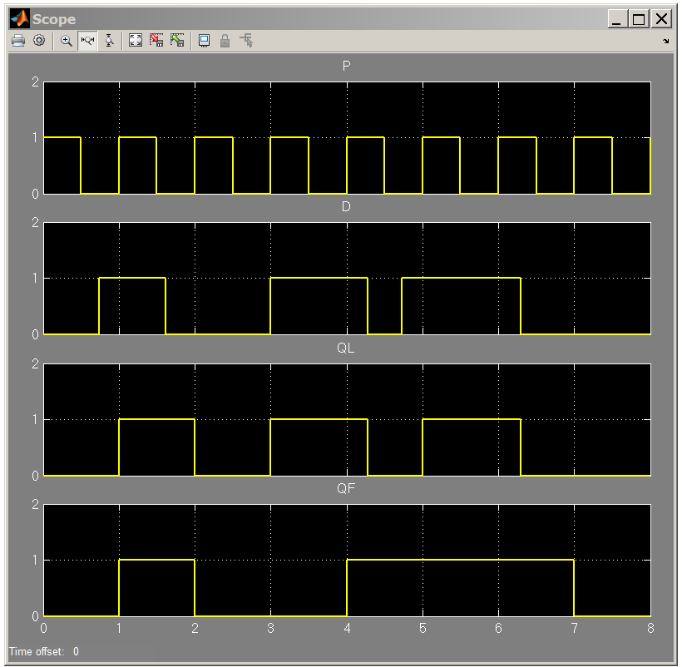
D flip-flop
positive-edge-triggered D flip-flop vs. D latch
D flip-flop copies D to Q on the rising edges of the clock, and remembers Q at all other times
for the latch,
input variations
are applied only
when clock is ON,
and QL output is preserved while clock is OFF
clock
D input
Q-latch
Q-flip-flop
clock edges
for the flip-flop,
input variations
are ignored between clock
rising edges

Slide 44
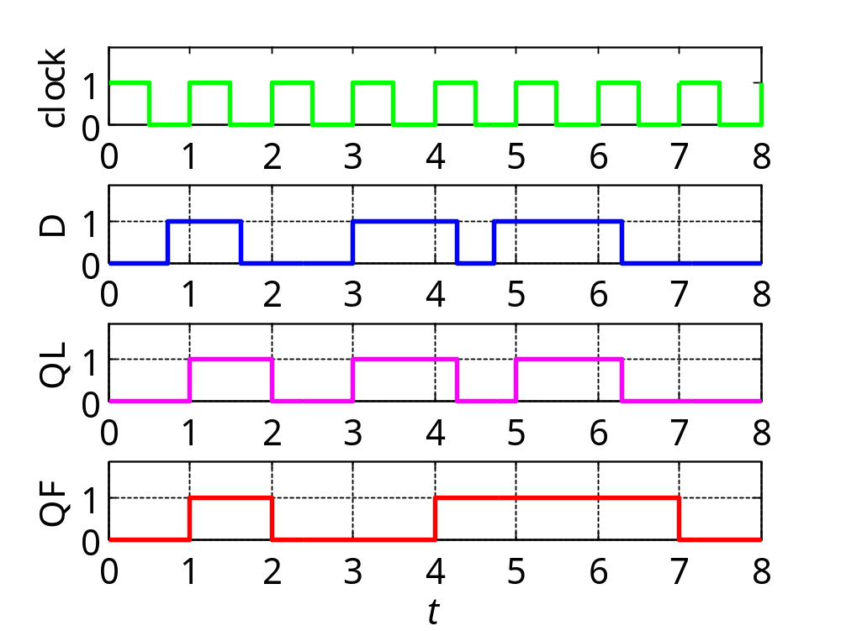
latch
D_{t} , if t at edge
Q_{t+1} =
Q_{t} , if t not at edge
flip-flop
D flip-flop
D C Q_{next}
x 0 Q
0 1 0
1 1 1
D E Q_{next}
x Q
0 0
1 1
positive clock edges
hold
follow
follow
hold
follow
follow
MATLAB code
for the flip-flop,
input variations
are ignored between clock
rising edges
for the latch,
input variations
are applied only
when clock is ON,
and QL output is preserved while clock is OFF

Slide 45
D flip-flop
%% DffLm.m - D flip-flop vs. D latch - on Canvas
% run DffLs.slx first to generate structure S
t = S.time; % time
P = S.data(:,1); % clock pulse
D = S.data(:,2); % D input
QL = S.data(:,3); % latch output
QF = S.data(:,4); % flip-flop output
set(0,'DefaultAxesFontSize',14);
figure;
subplot(4,1,1); stairs(t,P,'g-','linewidth',2);
xaxis(0,8,0:8); yaxis(0,1.9,0:1); ylabel('clock')
subplot(4,1,2); stairs(t,D,'b-','linewidth',2);
xaxis(0,8,0:8); yaxis(0,1.9,0:1); ylabel('D'); grid
subplot(4,1,3); stairs(t,QL,'m-','linewidth',2);
xaxis(0,8,0:8); yaxis(0,1.9,0:1); ylabel('QL'); grid
subplot(4,1,4); stairs(t,QF,'r-','linewidth',2);
xaxis(0,8,0:8); yaxis(0,1.9,0:1); ylabel('QF'); grid
xlabel('{\itt}')

Slide 46
Emona lab 5 experiment – comparing D-latches with D-flip-flops
D
S_{a}ʹ
Q
C
Qʹ
R_{a}ʹ
D
D
Q
D-latch
level-sensitive
clock
Clk
Qʹ
D
Q
D-flip-flop
positive-edge-triggered
>
Qʹ

Slide 47
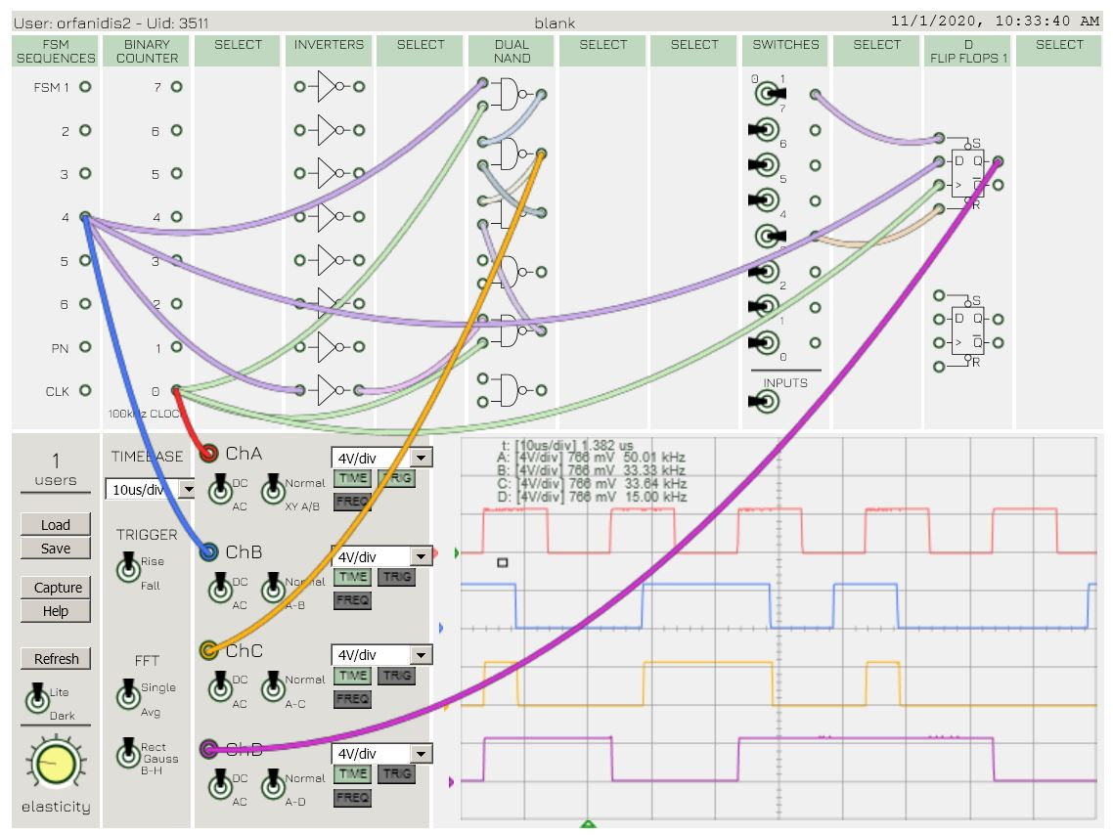
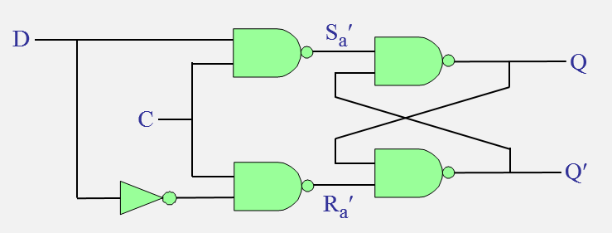
D-latch
start tracing outputs at these time instants

Slide 48
D flip-flop
positive-edge-triggered D flip-flop
Q
clock
Qʹ
D

Slide 49
a
P_{a}
P_{b}
Sʹ
b
e
Q
Sʹ Rʹ Q Q_{next} Qʹ_{next}
0 0 Q 1 1
0 1 Q 1 0
1 0 Q 0 1
1 1 Q Q Qʹ
clock
f
Qʹ
c
P_{c}
Rʹ
D
d
P_{d}
See next page for an explanation of its operation with the help of the truth-table of an SʹRʹ latch. It will be explored further in the DLD lab (lab5).

Slide 50
When clock = 0, the outputs of gates b & c are P_{b} = P_{c} = 1, which maintains the output latch (gates e & f) in its present state. In addition, P_{d} = Dʹ and P_{a} = D.
When the clock changes to clock = 1, then, the values of P_{a} and P_{d} are transmitted through gates b & c to cause P_{b} = Dʹ and P_{c} = D, thus, resulting in, Q = D and Qʹ = Dʹ.
After clock changes to 1, any further changes in D should not affect the output latch, as long as, clock = 1. There are two possibilities:
(a) if D = 0 at the positive edge of the clock, then, P_{c} = 0, keeping the output P_{d} = 1, as long as, clock = 1, regardless of the value of the D input, and maintaining Q = 0 = D_{edge.}
(b) if D = 1 at the positive edge of the clock, then, P_{b} = 0, forcing the outputs, P_{a} = 1, P_{c} = 1, regardless of the D input, and maintaining the output equal to Q = 1 = D_{edge.}
Therefore, the flip-flop ignores changes in the D input, while clock = 1. Hence, the circuit behaves as a positive-edge-triggered flip-flop.
Sʹ
Q
Sʹ Rʹ Q Q_{next} Qʹ_{next}
0 0 Q 1 1
0 1 Q 1 0
1 0 Q 0 1
1 1 Q Q Qʹ
Qʹ
Rʹ

Slide 51
Emona lab 5 experiment – verifying the six-NAND implementation
Q
clock
Qʹ
D

Slide 52
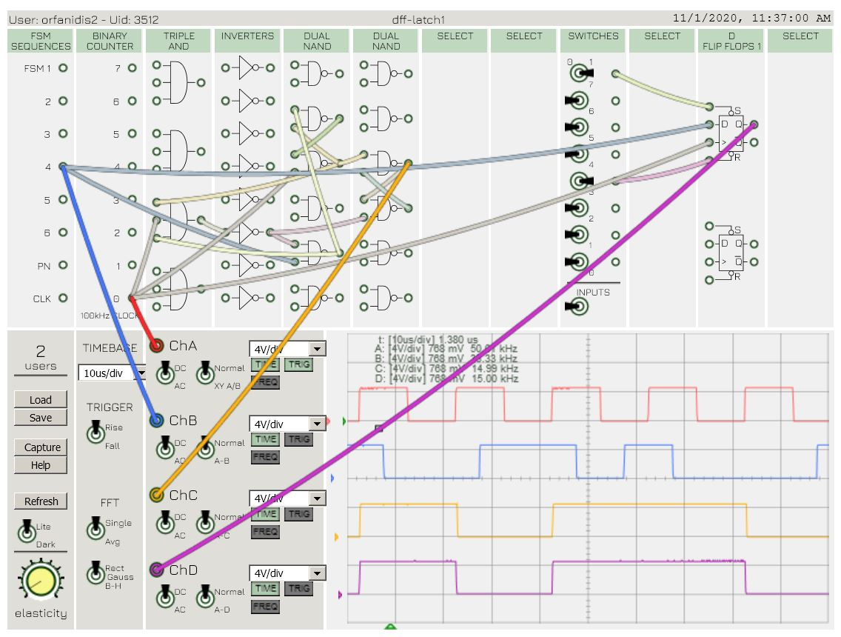
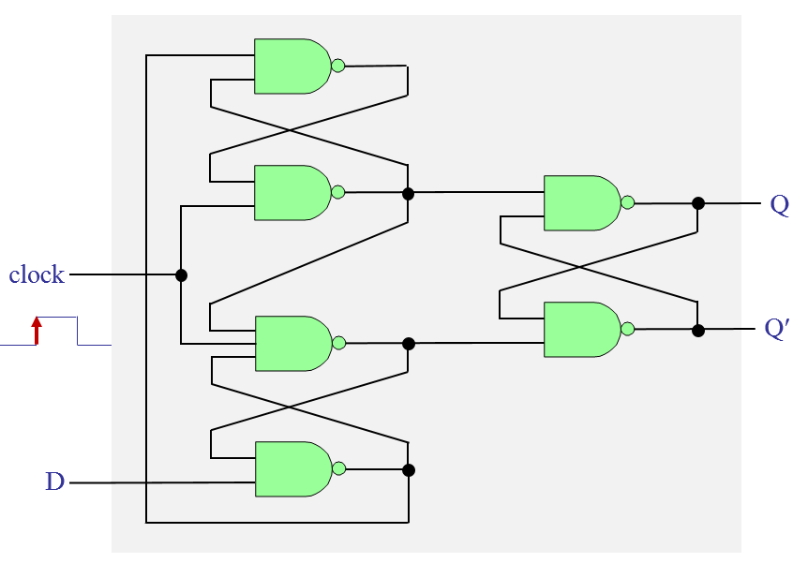
start tracing outputs at these time instants

Slide 53
D flip-flop
positive-edge-triggered D flip-flop – with preset/clear
presetʹ
preset and clear are
active-low
Q
clock
Qʹ
presetʹ
clearʹ
Q
D
D
>
Qʹ
clearʹ

Slide 54
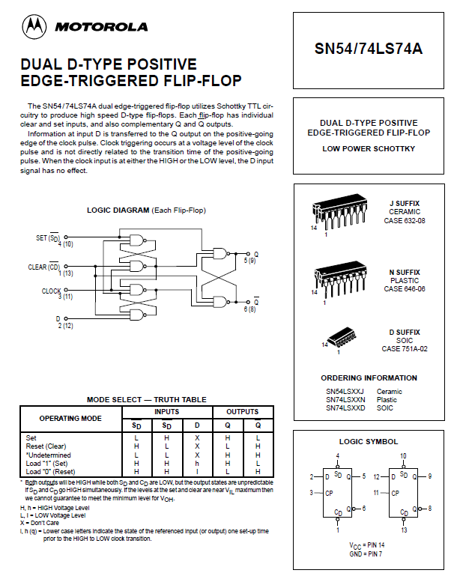
D flip-flop
D flip-flop ICs
54LS74
74LS74
from Motorola, TI, Fairchild

Slide 55
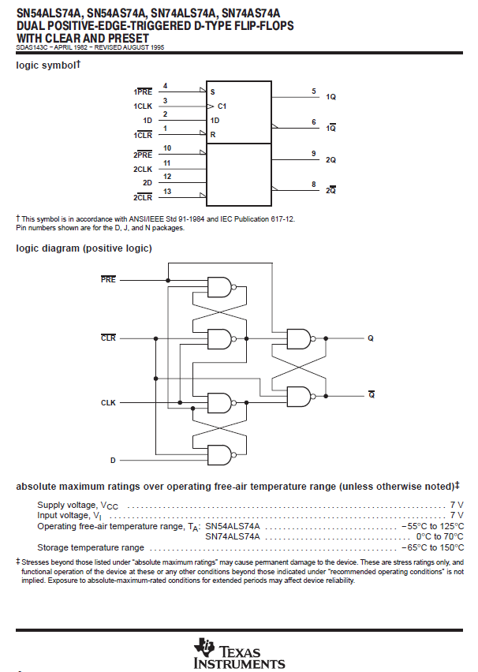
D flip-flop
D flip-flop ICs
54LS74
74LS74
from Motorola, TI, Fairchild

Slide 56
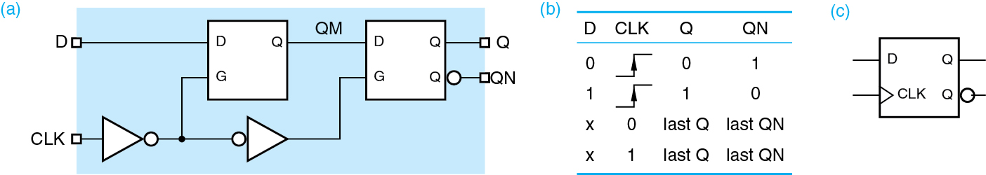
D flip-flop
positive-edge-triggered D flip-flop
can also be constructed by cascading two D-latches,
but driven by opposite clocks, see Wakerly, Sect. 10.2.4
FF₁
FF₂
when CLK = 0, FF₁ is open and follows its input, D
when CLK = 1, FF₁ is closed and its current output QM is transferred to FF₂’s output Q, and QM is prevented from changing until CLK=0 again,
FF₂ remains open while CLK = 1, but changes only at the rising edge of that interval because FF₁ is closed and not changing during the rest of the interval,
so effectively, D is transferred to Q only at the rising edges (0 to 1) of the clock period and Q maintains its state during the rest of the clock period

Slide 57

D flip-flop
cascading two D-latches together, and tying their control signals to opposite clocks
D
Q
C
Qʹ
D
Q
clock
C
Qʹ

Slide 58
D flip-flop
cascaded D latches
FF₁
FF₂
D
Q₁
Q₂
Q
Qʹ
clock
see Wakerly, Fig.10-13 for a timing diagram
hold 1
open 2
open 1
hold 2
This implementation will be explored in lab5, but note however, that the former implementation that uses three SR-latches (p. 53) is slightly more efficient, since it requires six NAND gates instead of eight, and is used in commercially available D-flip-flop ICs (see p. 54-55).

Slide 59
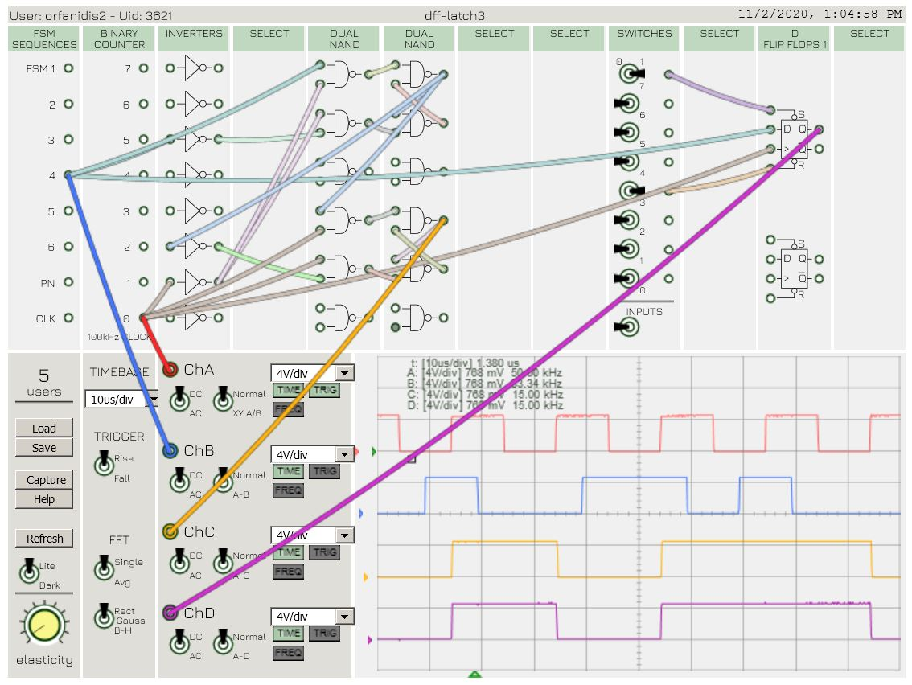
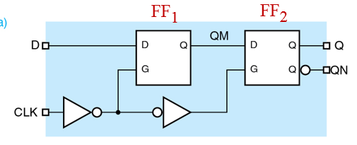
Q₁
Q
Q₂
start tracing outputs at these time instants
D
Q₂
Q

Slide 60
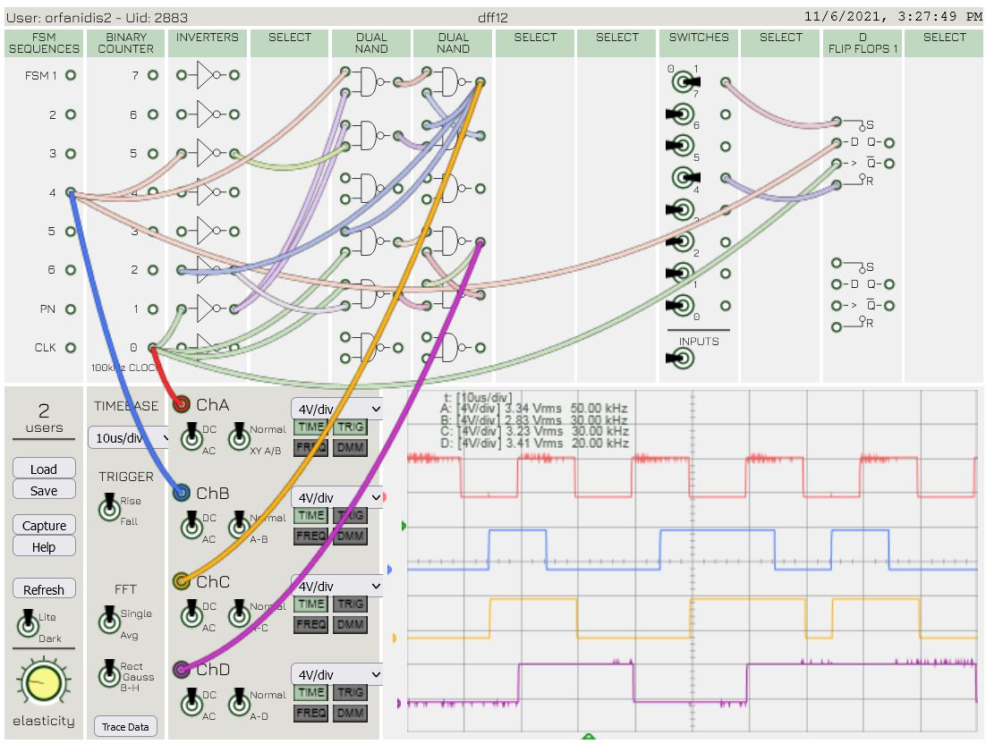
Q₁
Q₂
hold 1
open 2
open 1
hold 2
Q₁
edges
start tracing outputs at these time instants
hold 1
open 2
open 1
hold 2
hold 1
open 2
open 1
hold 2
hold 1
open 2
open 1
hold 2
hold 1
open 2
open 1
hold 2
hold 1
open 2
open 1
hold 2
D
Q₁
Q₂

Slide 61
D flip-flop
adding preset/clear inputs
presetʹ
D
Q
Qʹ
clock
clearʹ
preset and clear are active-low
presetʹ = 0, sets Q = 1
clearʹ = 0, sets Q = 0
presetʹ = 1, has no effect
clearʹ = 1, has no effect
presetʹ
D
Q
>
Qʹ
clearʹ

Slide 62
D flip-flop
cascaded D latches: slight variation that uses a
D latch followed by an SR latch
presetʹ
D
Q
Qʹ
clock
clearʹ
preset and clear are active-low
presetʹ = 0, sets Q = 1
clearʹ = 0, sets Q = 0
presetʹ = 1, has no effect
clearʹ = 1, has no effect
presetʹ
D
Q
>
Qʹ
clearʹ

Slide 63
D flip-flop - timing parameters
presetʹ
D
D
Q
Q
clock
>
Qʹ
Qʹ
clock edge
clearʹ
clock
t_{su} = setup time
t_{h} = hold time
t_{Q} = clock-to-Q delay
all typically, 1-20 ns
t_{su}
t_{h}
t_{su}
t_{h}
D
Q
t_{Q}
t_{Q}

Slide 64
D flip-flops and State Machines
edge-triggered D-flip-flops
x_{t}
y_{t}
s
Q_{t+1}
Q_{t}
y_{t} = G(x_{t ,} Q_{t})
Q_{t+1} = F(x_{t} , Q_{t})
t

Slide 65
D flip-flops and State Machines
D flip-flops are widely used for the implementation of finite-state machines. Their advantage is that the next states, Q^{next}, are the excitation inputs to the flip-flops, i.e., D = Q^{next} . See next page for an alternative drawing.
feedback
Q
D Q
flip-flops
D = Q^{next}
present
states
next-state
logic
&
output
networks
Q^{next}
>
clock
multiple flip-flops
X
Y
multiple states
inputs
outputs
multiple inputs and outputs

Slide 66
D flip-flops and State Machines
multiple states
feedback
D = Q^{next}
Q
D Q
Q
next-state
logic
&
output
networks
Q^{next}
states
>
Qʹ
clock
flip-flops
X
Y
inputs
outputs
multiple flip-flops
multiple inputs and outputs

Slide 67
D flip-flops and State Machines – example with two states
feedback
Q₁
Q₁^{next}
D₁ Q₁
Q₁
Q₂
>
Q₁ʹ
next-state
logic
&
output
networks
flip-flops
Q₂^{next}
D₂ Q₂
Q₂
>
Q₂ʹ
clock
D₁ = Q₁^{next}
D₂ = Q₂^{next}
X
Y
inputs
outputs

Slide 68
other flip-flop types
SR flip-flops
T flip-flops
JK flip-flops
conversions between types
characteristic tables
characteristic equations
excitation tables
excitation equations
D to JK
JK to D
D to T
T to D
JK to T
T to JK
SR to JK
JK to SR
explored in recitations

Slide 69
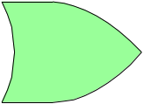
T flip-flop – constructed from a D flip-flop
D
Q
Q
T
>
Qʹ
Qʹ
clock
XOR
T E Q_{next}
0 Q
1 Qʹ
T flip-flop
characteristic equation
hold
Q_{next}= D = Tʹ Q + T Qʹ = T ⊕ Q
toggle

Slide 70
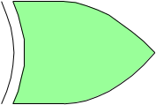
T flip-flop – constructed from a D flip-flop
Q
T
clock
>
Qʹ
D
Q
Q
T
clock
>
Qʹ
Qʹ
0 ⊕ X = X
1 ⊕ X = Xʹ
Q_{next} = D = T ⊕ Q
characteristic table
T E Q_{next}
0 Q
1 Qʹ
T flip-flop
characteristic equation
hold
Q_{next}= D = Tʹ Q + T Qʹ = T ⊕ Q
toggle

Slide 71
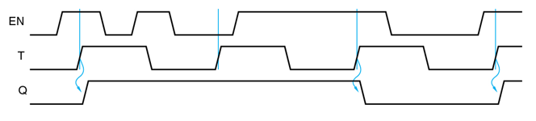
T flip-flop – constructed from a D flip-flop
D
Q
Q
T
clock
>
Qʹ
Qʹ
0 ⊕ X = X
1 ⊕ X = Xʹ
Q_{next} = D = T ⊕ Q
T
clock
Q
toggle
toggle
toggle

Slide 72
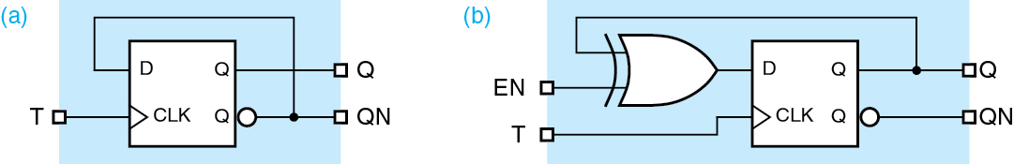
T flip-flop – constructed from a D flip-flop
Wakerly version
T
clock

Slide 73
T flip-flop
T
Q
clock
>
Qʹ
excitation table
characteristic table
Q Q_{next} T
0 0 0
0 1 1
1 0 1
1 1 0
T Q_{next}
0 Q
1 Qʹ
hold
toggle
characteristic equation
excitation equation
Q_{next} = Tʹ Q + T Qʹ = T ⊕ Q
T = Q_{next} ⊕ Q
excitation tables are useful because we usually know Q and what Q_{next} should be, and we need to determine the proper inputs to the flip-flops

Slide 74
T flip-flop
converting a T flip-flop to a D flip-flop
T
Q
Q
D
clock
>
Qʹ
Qʹ
T = D ⊕ Q
Q_{next} = T ⊕ Q = (D ⊕ Q) ⊕ Q = D

Slide 75
JK flip-flop
positive-edge-triggered JK flip-flop,
acts like an SR flip-flop, but toggling when S=R=1
S R Q Q_{next} Qʹ_{next}
0 0 Q Q Qʹ
0 1 Q 0 1
1 0 Q 1 0
1 1 Q 0 0
J
D
Q
Q
K
>
Qʹ
Qʹ
clock
JK flip-flop
characteristic equation
J
Q
clock
>
Q_{next}= D = J Qʹ + Kʹ Q
K
Qʹ

Slide 76
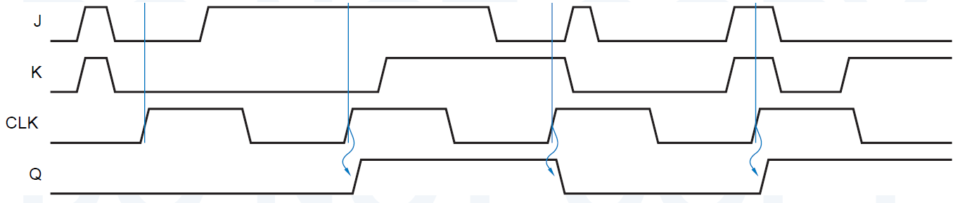
JK flip-flop
clock edge signal
S R Q Q_{next} Qʹ_{next}
0 0 Q Q Qʹ
0 1 Q 0 1
1 0 Q 1 0
1 1 Q 0 0
J K E Q_{next}
x x Q
0 0 Q
0 1 0
1 0 1
1 1 Qʹ
hold
hold
reset
set
toggle
JK flip-flop
characteristic equation
Q_{next} = J Qʹ + Kʹ Q
Qʹ + Q = 1
hold set reset toggle
J
K
clock
Q

Slide 77
JK flip-flop
J
Q
clock
>
K
Qʹ
characteristic table
excitation table
J K Q_{next}
0 0 Q
0 1 0
1 0 1
1 1 Qʹ
Q Q_{next} J K
0 0 0 x
0 1 1 x
1 0 x 1
1 1 x 0
K-map for Q_{next}
JK
Q
00 01 11 10
0 0 0 1 1
1 1 0 0 1
characteristic equation
Q_{next} = J Qʹ + Kʹ Q

Slide 78
JK flip-flop
J
Q
clock
>
K
Qʹ
characteristic table
J K Q Q_{next}
0 0 0 0
0 0 1 1
0 1 0 0
0 1 1 0
1 0 0 1
1 0 1 1
1 1 0 1
1 1 1 0
characteristic table
excitation table
J K Q_{next}
0 0 Q
0 1 0
1 0 1
1 1 Qʹ
Q Q_{next} J K
0 0 0 x
0 1 1 x
1 0 x 1
1 1 x 0
K-map for Q_{next}
JK
Q
00 01 11 10
0 0 0 1 1
1 1 0 0 1
characteristic equation
Q_{next} = J Qʹ + Kʹ Q

Slide 79
JK flip-flop
converting a JK flip-flop to a T flip-flop
T
J
Q
>
K
Qʹ
clock
J = K = T
Q_{next} = J Qʹ + Kʹ Q
Q_{next} = T Qʹ + Tʹ Q = T ⊕ Q

Slide 80

JK flip-flop
converting a JK flip-flop to a D flip-flop
D
J
Q
K-map for J
>
D
Q
0 1
0 1
1 x x
K
Qʹ
clock
excitation table
D Q Q_{next}
0 0 0
0 1 0
1 0 1
1 1 1
Q Q_{next} J K
0 0 0 x
0 1 1 x
1 0 x 1
1 1 x 0
K-map for K
J = D
K = Dʹ
Q_{next} = J Qʹ + Kʹ Q = D Qʹ + D Q = D
Q_{next} = D
D
Q
0 1
0 x x
1 1

Slide 81
flip-flop conversions - summary & web links
D to JK: D = J Qʹ + Kʹ Q
JK to D: J = D, K = Dʹ
D to T: D = T ⊕ Q
T to D: T= D ⊕ Q
JK to T: J = K = T
T to JK: T = J Qʹ + K Q
SR to JK: S = JQʹ, R = KQ
JK to SR: J = S, K = R
flip-flop conversions - part 1
flip-flop conversions - part 2
flip-flop conversions - part 3
flip-flop conversions - part 4
to be explored further in recitations

Slide 82
excitation tables
excitation tables are useful because we usually know what Q and Q_{next} should be, and wish to determine the proper inputs to the flip-flops
D flip-flop
T flip-flop
Q Q_{next} D
0 0 0
0 1 1
1 0 1
1 1 0
Q Q_{next} T
0 0 0
0 1 1
1 0 1
1 1 0
Q_{next} = D
Q_{next} = T ⊕ Q
characteristic
equations
characteristic
equations
SR flip-flop
JK flip-flop
Q Q_{next} S R
0 0 0 x
0 1 1 0
1 0 0 1
1 1 x 0
Q Q_{next} J K
0 0 0 x
0 1 1 x
1 0 x 1
1 1 x 0
Q_{next} = S + Rʹ Q
Q_{next} = J Qʹ + Kʹ Q

Slide 83
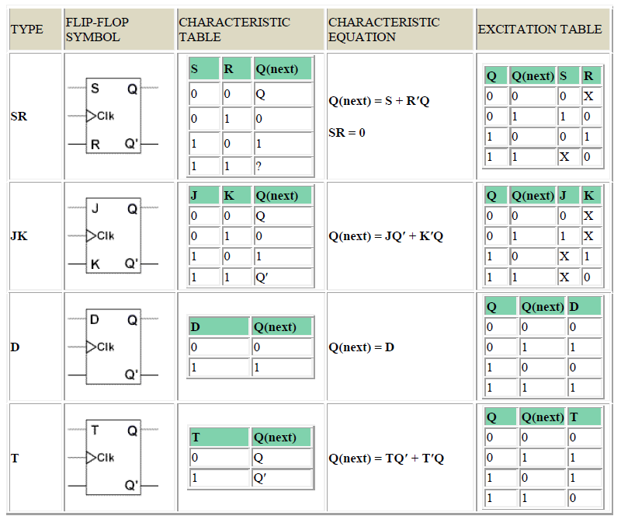
flip-flops - summary
Reference: A .F. Kana, DLD lectures (on Canvas)

